Slide 1
PG AND RESEARCH DEPARTMENT OF COMMERCE
PROMINENT ALUMNAE

Slide 2
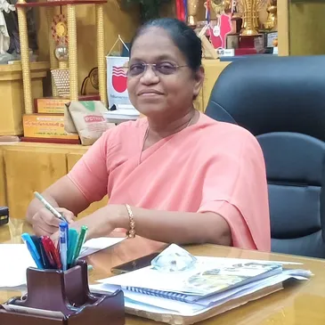
Name: Dr. (Sr.) A . Christina Bridget
Batch: B.Com. 1981 -1984
Department: Commerce
Designation: Former Principal – Holy Cross College, Tiruchirappalli-2
Field of excellence: Academics
Achievements:
Women of Wonder Award for Innovative Practices for Academic Excellence - RED LABS, Trichy, 2021
Dr. Sam Higginbottom Award for the Best Principal of India - All India Association for Christian Higher Education (AIACHE), New Delhi, 2021
Highest Number of Certifications, Finmark, 2022
Certificate of Merit - Institutional Self Study for Assessment and Accreditation by NAAC (Holy Cross College (Autonomous), Tiruchirappalli
Member of ‘Waves’ Magazine - Sisters of the Cross of Chavanod – 5 years (1997 – 2002)
Member of NAAC Preparation Committee 1998
Member of Networking and Information Dissemination Cell – 2 years (NID Cell) 2013- 2015
Certified Examiner in Quality Assessment - Bannari Amman Institute of Technology, Sathyamangalam, 26th & 27th November 2015
External Examiner - IMC Quality Award Examiner

Slide 3
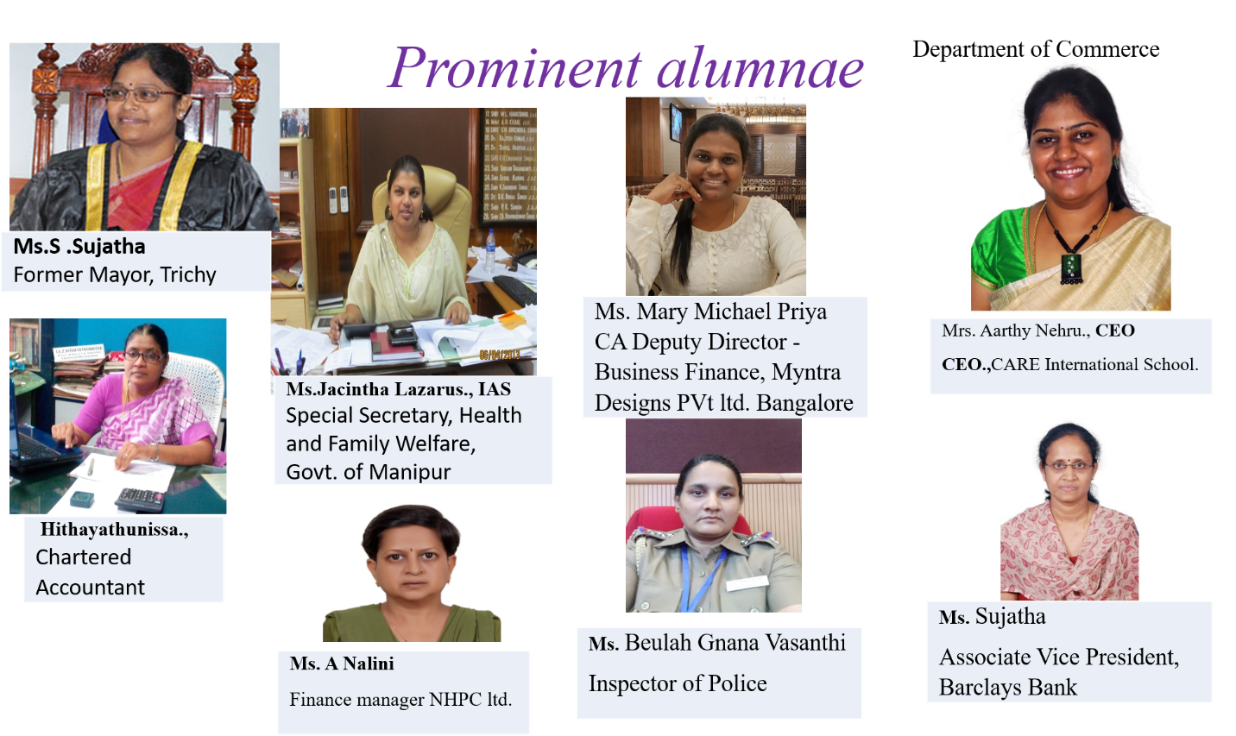
Name: Honourable Former Mayor, Ms. S. Sujatha
Batch: B.Com. 1991-1994
Department: Commerce
Designation: Vice President - All India Congress Committee
Field of excellence: Administrative Service
Achievements:
Former Mayor, Tiruchirappalli Corporation, Unanimously elected as the Honourable Mayor of Tiruchirappalli in June 2009 - in office for two years 2010 and 2011
During her tenure, Tiruchirappalli City was ranked 6th in the national rating of cities under the National Urban Sanitation Policy
Deputy Secretary of the District Youth Congress in 1990
President of District Congress Demographic Peravai from 2001-2005
Director, Indian Overseas Bank, 2013-2015
Councillor – 31st Ward , Tiruchirappalli Corporation , 2015-2018

Slide 4
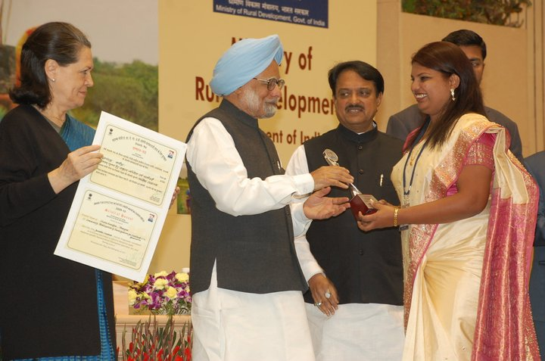
Name: Ms. Jacintha Lazarus IAS
Batch: B.Com. 1997-2000
Department: Commerce
Designation: Executive Director (South) - FCI
Field of excellence: Administrative Service
Achievements:
Secured 27th rank at all India level and was allotted Manipur Cadre in the year 2004; Secretary (Water Resources/ Minor Irrigations/ Information Technology/ MOBC), Government of Manipur; Under her able administration, the district of Churachandpur was bestowed the National Award for the best performing district under Mahatma Gandhi NREGA for 2009-10 by the Ministry of Rural Development, Government of India
In 2018, the Ministry of Rural Development awarded the Manipur Social Welfare Department, the 3rd Rank for its efforts and contributions in implementing 100 percent Direct Benefit Transfer (DBT). Ms. Jacintha IAS., the Secretary, Social Welfare Department, received the award; Manipur has also been declared the 2nd State for 100% DBT for release of old age pension
In 2020, posted as Director, Rehabilitation and Welfare of non- Resident Tamils, Tamil Nadu
Commissioner, Welfare of the Differently Abled, Tamil Nadu from 2022

Slide 5
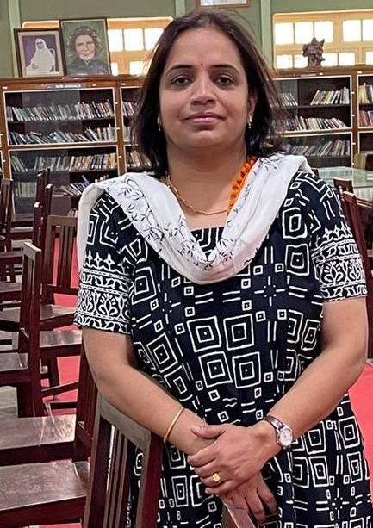
Name: Ms. Srividhya Sivakumar
Batch: B.Com. 1994-1997
Department: Commerce
Designation: Lecturer in Business Management, Sixth Form College,
Farnborough, United Kingdom
Field of excellence: Consultant in Academics for Universities in UK

Slide 6
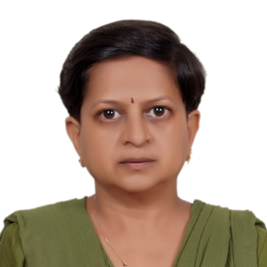
Name: ARUNACHALAM NALINI,
Batch: B.Com. 1986-1989
Department: Commerce
Designation: Sr. Manager Finance, NHPC Ltd, Treasury Management.
Field of excellence: Administration - Finance
Achievements:
Felicitation on NHPC raising Day, 2017, with Secretary Power, CMD and Directors of NHPC ltd, MLA and Mayor Faridabad, Haryana.
Nav Bharat Times Award, 2018 with Sh. Kishan Pal Kujjar, Honourable Minister for Social Justice and Empowerment and Mayor Faridabad
Best Woman Employee Award, 2014 with Honourable Minister for Petroleum & Natural Gas and Minister for Textiles, Dr. Panabaka Lakshmi
Won 4 Gold Medals and 1 Bronze Medal at World Dwarf Games, 2013, Michigan, USA
Won Bronze medal in National Para Badminton Championship 2020 held at Orissa in Dec2021
Sh. A. K. Singh, CMD NHPC Ltd, Felicitated after the National Para Badminton Championship 2020 held at Orissa during the month of December 2021.
5th Indian Open Para Athletics International Championship, 2023 held at Bangalore from 4th May to 7th May23 and won Bronze Medal in Discus throw.

Slide 7
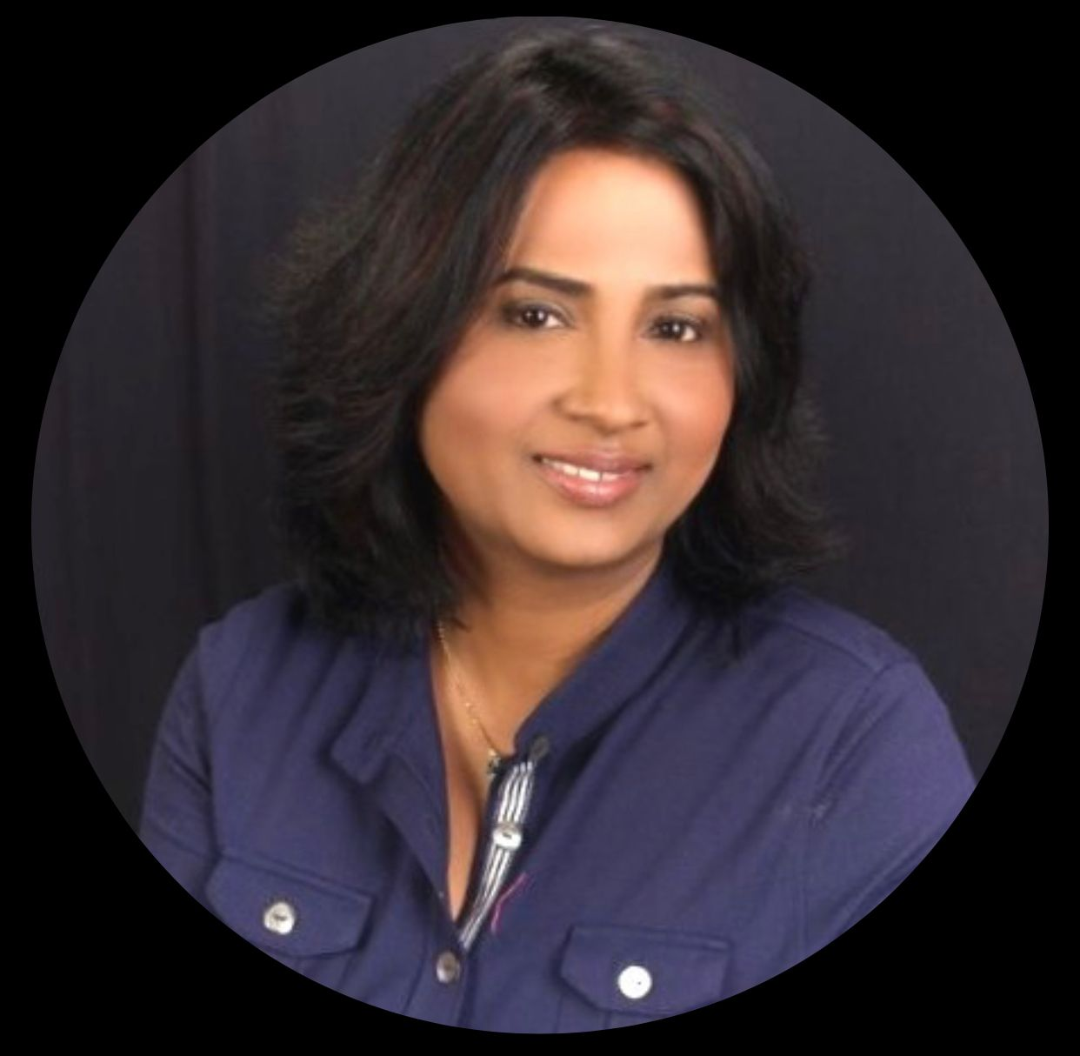
Name: Sujatha Ramesh
Batch: B.Com. 1988-1991
Department: Commerce
Designation: Head of Business Administration, Operational Risk Management-Chief Administrative Office, Citigroup Inc. –Tampa, Florida, USA
Field of excellence: All areas of business administration that provide financials, operational support and guidance to drive the execution of budget plan/forecast, continuity of business, location strategy and issue management

