Slide 1
Holy Cross College (Autonomous) Tiruchirappalli – 620 002
Affiliated to Bharathidasan University Nationally Accredited (4th Cycle) with ‘A ++ ’ Grade (CGPA 3.75 / 4) by NAAC College with Potential for Excellence DST-FIST Sponsored College of Excellence ‘Star College’ Status by DBT Tiruchirapalli – 620 002.
CENTRALIZED INSTRUMENTATION FACILITY (CIF)

Slide 2
About CIF
The Centralized Instrumentation Facility (CIF), was established by Department of Science and Technology (DST).
The Purpose of establishing these centres is to provide data collection facility from analytical equipments to scientific community for their advanced research with nominal charges.
The Facility has grown into a major centre for spectral measurements, molecular and crystal structure determination and materials characterization.

Slide 3
OBJECTIVES
To carry out analysis of samples received from academics, research institutions and other organizations.
To provide instrumental facilities for analyst as an outsource, to undertake project and research works.
To organize periodic short-term workshops on the application of various spectroscopic and analytical techniques for students, teachers and personnel.
To carry out and support various sponsored research project

Slide 4
FACILITY
Hitachi UV-Visible Spectrophotometer (U-2910)
Jasco Raman Spectroscopy (PR-1w)
Thermo Fisher TRACE GC ULTRA GC-MS/MS (ITQ 900)
Shimadzu FTIR IR Affinity-1 (Miracle 10)
Bruker Powder X-Ray Diffraction (D8 Advance)
Agilent Technologies HPLC (1220) Infinity LC
Ivium Technology Electrochemistry Vertex Work Station (V-55648)

Slide 5
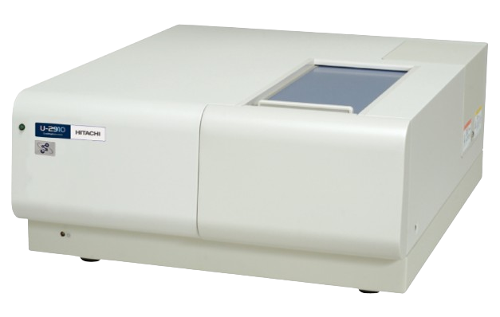
UV VISIBLE SPECTROPHOTOMETER
SAMPLE TYPE
LIQUID
APPLICATION
UV absorption spectrophotometer is the best method for the determination of the purity of organic compounds.
If any impurities are present in the organic compounds then the additional peaks appear at the specific wavelength in the spectrum.
MAKE : HITACHI
MODEL : U-2910

Slide 6
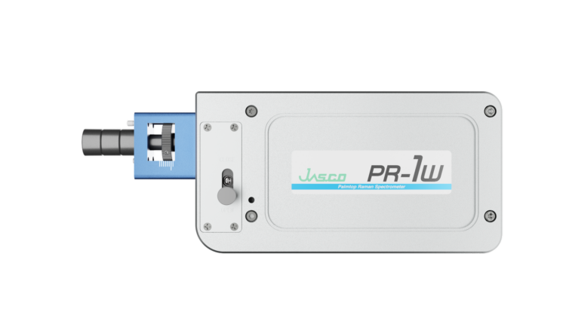
PALMTOP RAMAN SPECTROMETER
SAMPLE TYPE
SOLID
LIQUID
THIN-FLIM
APPLICATION
MAKE : JASCO
MODEL : PR-1W (Spec : 785nm)
To Identify Functional Group of Chemical compounds.
Raman scattering is about a million times less intense than Rayleigh Scattering.

Slide 7
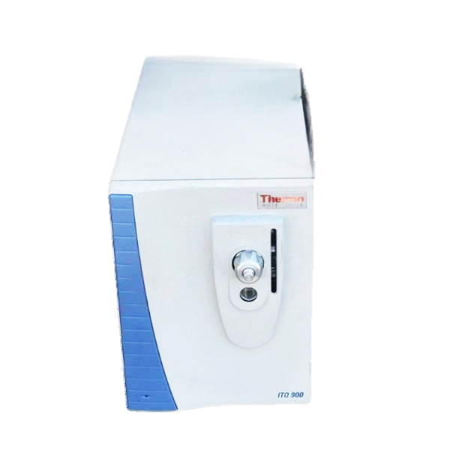
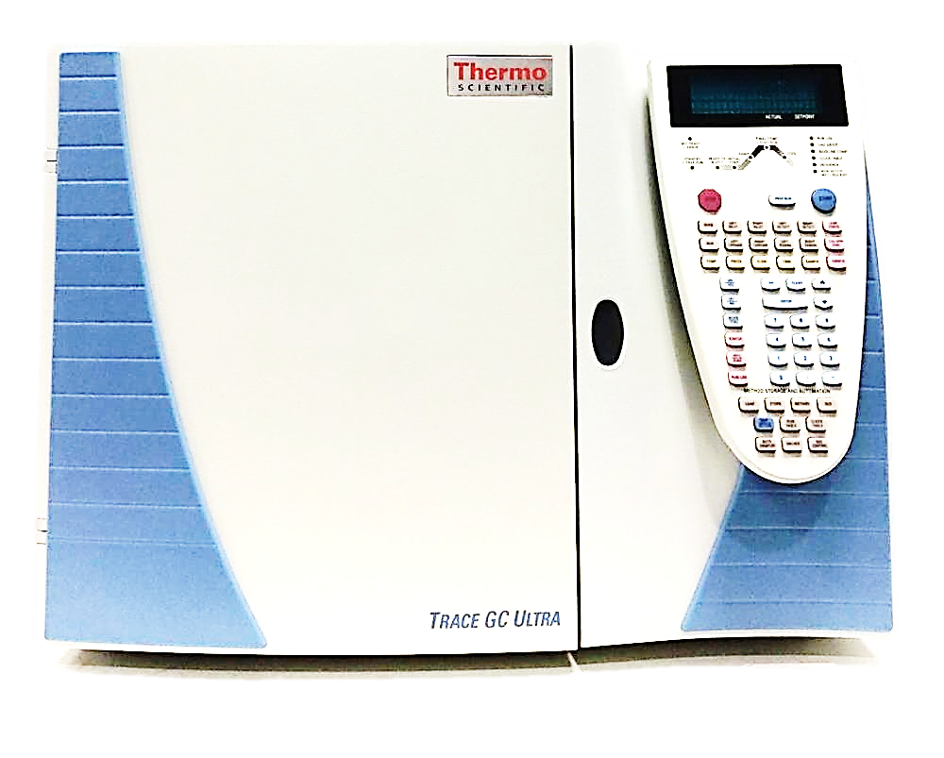
GAS CHROMATOGRAPHY MASS SPECTROMETRY (GC-MS/MS)
SAMPLE TYPE
SOLID
LIQUID
APPLICATION
GC-MS/MS provides enhanced sample identification, higher sensitivity, an increased range of analyzable samples, and faster results.
A tandem mass spectrometer is used which allows us to select specific analytes for individual fragmentation. This allows more complex mixtures to be analysed more readily.
MAKE : THERMO FISHER
MODEL : TRACE GC ULTRA (ITQ 900)

Slide 8
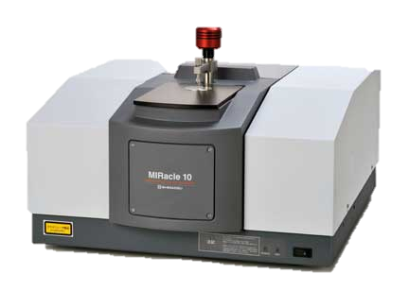
FOURIER TRANSFORM INFRARED SPECTROPHOTOMETER (FTIR)
SAMPLE TYPE
SOLID
LIQUID
APPLICATION
It is also utilized for functional group identification in unknown compounds.
It is used to identify reaction components and conduct kinetic studies on reactions.
MAKE : SHIMADZU
MODEL : AFFINITY-1 (MIRACLE 10)

Slide 9
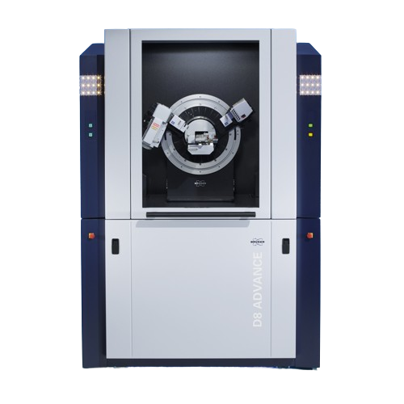
POWDER X-RAY DIFRACTION (XRD)
SAMPLE TYPE
SOLID
THIN-FLIM
APPLICATION
Measurement of sample purity.
Identification of fine-grained minerals such as clays and mixed layer clays that are difficult to determine optically.
Study of change in crystalline phase via the position of the diffraction peak.
MAKE : BRUKER
MODEL : D8 ADVANCE

Slide 10
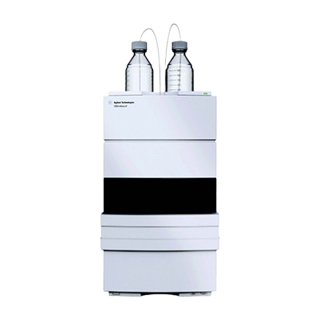
HIGH PERFORMANCE LIQUID CHROMATOGRAPHY (HPLC)
SAMPLE TYPE
LIQUID
APPLICATION
Product purity and quality control of industrial products and fine chemicals.
Separation and purification of biopolymers such as enzymes or nucleic acids.
MAKE : AGILENT TECHNOLOGIES
MODEL : 1220 INFINITY LC

Slide 11
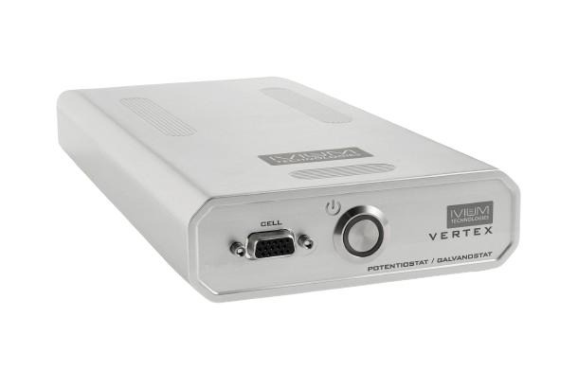
ELECTRO CHEMISTRY VERTEX WORKSTATION
SAMPLE TYPE
SOLID
LIQUID
APPLICATION
They provide researchers with the ability to apply controlled potentials or currents to electrodes and measure the resulting electrochemical reactions.
These workstations play a crucial role in various fields, such as battery technology, corrosion studies, material characterization, and fundamental research.
MAKE : IVIUM TECHNOLOGY
MODEL : VERTEX (V-55648)

Slide 12
CONTACT US,
Mr.M.ABDUL HAKKIM
cif@hcctrichy.ac.in
+91-7200675529
0431-2700637

