Slide 1


HOLY CROSS COLLEGE (Autonomous)
Affiliated to Bharathidasan University
Nationally Accredited (4th Cycle) with A++ Grade (CGPA 3.75/4) by NAAC
College with Potential for Excellence
Tiruchirappalli - 620 002, Tamil Nadu, India.
DEANERY OF INTERNATIONAL AFFAIRS
cordially invites you to
MoU Synergy: Fostering Academic Excellence
with a visit from
St. Aloysius College,
Jabalpur, India
DATE: 10 FEBRUARY 2026 TIME: 9 a.m.

Slide 2
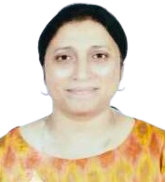
A Hearty Welcome to the Visiting Faculty
DR. SIBY SAMUEL
IQAC Coordinator & Head,
Department of Computer Science,
St. Aloysius College, Jabalpur.
Madhya Pradesh, India

Slide 3

A Hearty Welcome to the Visiting Faculty
DR. RUPALI ALUWALIA
Director – Internal Collaboration
Head, Department of Commerce
St. Aloysius College, Jabalpur,
Madhya Pradesh, India

Slide 4


